Slide 1
Modern Web Architecture

Slide 2
Modern Web Architecture
The problem with the Classic Web Architecture model
The classic web architecture model works by triggering an HTTP request from the interface back to a web server. The server does some processing; retrieving data, crunching numbers, talking to various legacy systems, etc. and then returns an HTML page to the client.
This approach doesn’t make for a great user experience. While the server is doing its thing, what’s the user doing? Waiting! And at every step in a task, the user waits some more.
If we were designing the Web from scratch for applications, we wouldn’t make users wait around. Once an interface is loaded, why should the user interaction come to a halt every time the application needs something from the server? In fact, why should the user see the application go to the server at all?

Slide 3
Modern Web Architecture
Introducing Ajax
Ajax stands for Asynchronous JavaScript and XML. More on this in a bit…
An Ajax application eliminates the start-stop-start-stop nature of interaction on the Web by introducing an intermediary (an Ajax engine) between the user and the server.
Instead of loading a webpage at the start of the session, the browser loads an Ajax engine which is responsible for both rendering the interface the user sees and communicating with the server. The engine allows the interaction with the application to happen asynchronously (independent of communication with the server). So the user is never staring at a blank browser window and an hourglass icon.
User actions that normally generate HTTP requests take the form of JavaScript calls to the Ajax engine.
Any response to a user action that doesn’t require a trip back to the server such as simple data validation, editing data in memory, and even navigation, the engine handles on its own. If the engine needs something from the server in order to respond, the engine makes those requests asynchronously, without stalling a user’s interaction with the application.

Slide 4
Modern Web Architecture
Defining Ajax
Ajax isn’t a technology. It’s really several technologies, each flourishing in its own right, coming together in powerful new ways. Ajax incorporates:
Standards-based presentation using HTML and CSS
Dynamic display and interaction using the Document Object Model
Data interchange and manipulation using XML
Asynchronous data retrieval using the browsers XMLHttpRequest object
JavaScript binding everything together

Slide 5




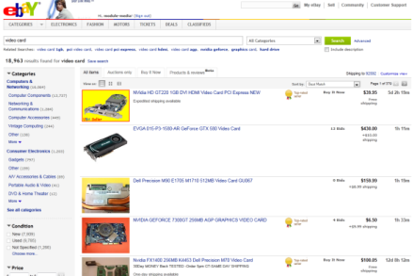

Modern Web Architecture
The Modern Architecture Model
Visitor (Client) HTML, CSS, JavaScript
Web Server PHP, ASP, JSP, Ruby
HTML + CSS
Ajax Engine
XML Data
JavaScript Call
HTTP Request
Data Request (Query)
Dataset
Database SQL Server, Oracle, MySQL, DB2

Slide 6
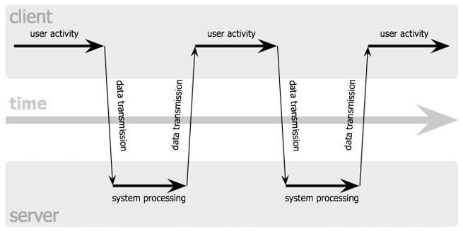
Modern Web Architecture
The Modern Architecture Model (Synchronous vs Asynchronous)
The Synchronous Model

Slide 7
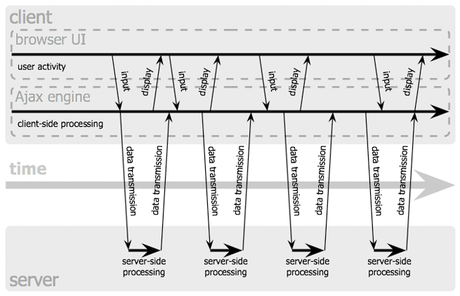
Modern Web Architecture
The Modern Architecture Model (Synchronous vs Asynchronous)
The Asynchronous Model

